Slide 1
Data Structures Algorithm and Design SSZG519
Mr. Chennupati R Prasanna

Slide 2
SSZG519- Heap Sort

Slide 3
Heap-Sort Algorithm
Heap sort is one of the best sorting methods being in-place and with no quadratic worst-case scenarios.
Heap sort is divided into two basic parts
Creating a heap of the unsorted list
Then a sorted array is created by repeating removing the largest/smallest element form the heap and inserting it into the array
Heap is reconstructed after each removal

Slide 4
What is a Heap?
Heap is a special tree-based data structure, that satisfies the following special heap properties.
Shape Property
Heap Property

Slide 5
Shape Property
Heap data structure is always a complete binary tree, which means all levels of the tree are fully filled.
Complete Binary tree

Slide 6
Heap Property
All nodes are either[greater than or equal to] or [less than or equal to] each of its children.
If the parent nodes are greater than their children, heap is called:Max-Heap
If the parent nodes are smaller than their children, heap is called:Min-Heap

Slide 7
Why study Heapsort?
It is a well-known, traditional sorting algorithm you will be expected to know
Heapsort is always O(n log n)
Quicksort is usually O(n log n) but in the worst case slows to O(n²)
Quicksort is generally faster, but Heapsort is better in time-critical applications
Heapsort is a really cool algorithm!

Slide 8
Heap
A binary heap is a complete/left-justified binary tree in which each node other than root is smaller than its parent.
Heap example:
25
22
17
19
22
14
15
18
14
21
3
9
11

Slide 9
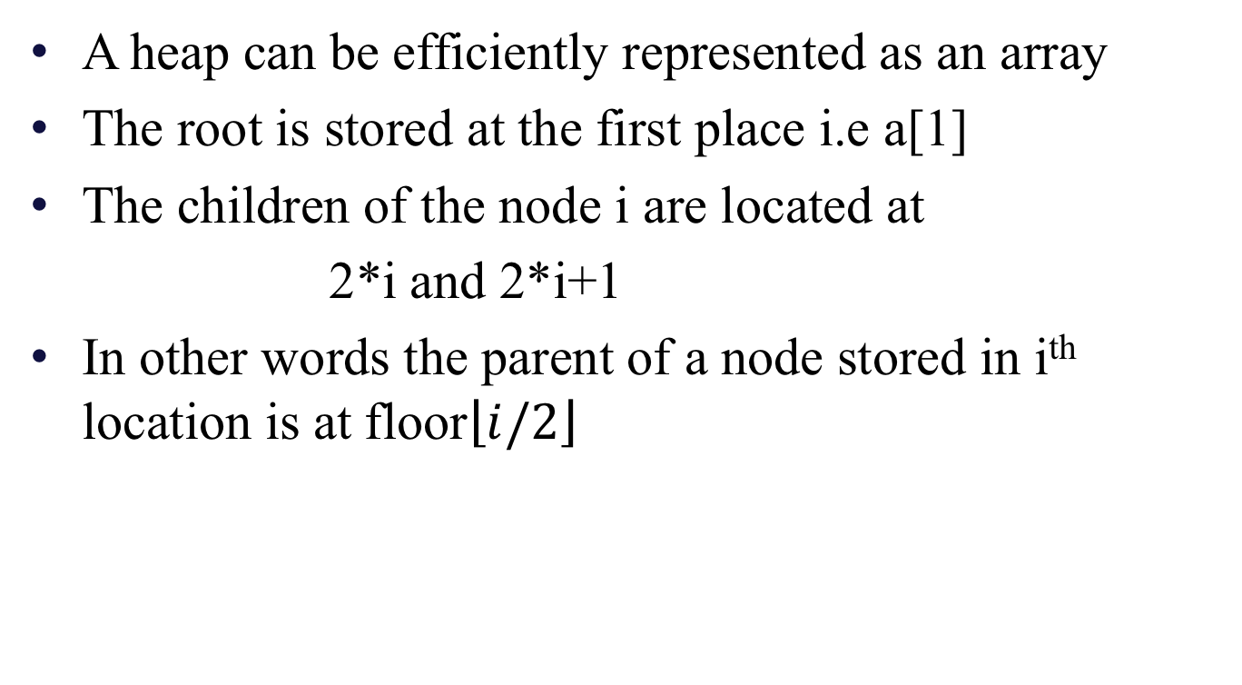
Heap Representation
A heap can be efficiently represented as an array
The root is stored at the first place i.e a[1]
The children of the node i are located at
2*i and 2*i+1
In other words the parent of a node stored in i^{th} location is at floor$\left\lfloor i/2\right\rfloor$

Slide 10
Heap Representation(Cont..,)
25
22
17
19
22
14
15
18
14
21
3
9
11
0 1 2 3 4 5 6 7 8 9 10 11 12
25
22
17
19
22
14
15
18
14
21
3
9
11
Notice:
The left child of index i is at index 2*i+1
The right child of index i is at index 2*i+2
Example: the children of node 3 (19) are 7 (18) and 8 (14)

Slide 11
Heapification
Before discussing the method for building heap of an arbitrary complete binary tree, we discuss a simpler problem.
Let us consider a binary tree in which left and right subtrees of the root satisfy the heap property but not the root.
See the following fig
Now the Question is how to transform the above tree into a Heap?
2
14
8
10
12
4
6
7
9
5
11
3

Slide 12
Solution for the Question
Swap the root and left child of root, to make the root satisfy the heap property.
Then check the subtree rooted at left child of the root is heap or not. If it is we are done, if not repeat the above action of swapping the root with the maximum of its children.
That is, push down the element at root till it satisfies the heap property.
The following sequence of fig depicts the heapification process

Slide 13
Sequence of fig depicts the heapification process
2
14
14
8
2
8
10
12
4
6
10
12
4
6
7
9
5
11
3
7
9
5
11
3
14
14
12
8
12
8
10
2
4
6
10
11
4
6
7
9
5
11
3
7
9
5
2
3

Slide 14
Algorithm: Heapification(a,i,n)
Step1: left = 2^{i}
Step2: right = 2^{i} +1
Step3: if(left<n) and (a[left]>a) then
Step4: maximum = left
Step5: else
Step6: maximum = i
Step7: if (right<n) and (a[right]>a[maximum]) then
Step8: maximum = right
Step9: if (maximum!=i) then
Step10: swap(a[i],a[maximum])
Step11: heapfication (a,maximum,n)
The time complexity of heapification is O(logn)
*Since the binary tree is perfectly balanced, sifting up a single node takes O(log n) time

Slide 15
Build Heap
Heap building can be done efficiently with bottom up fashion.
Given an arbitrary complete binary tree, we can assume each leaf is a heap
Start building the heap from the parents of these leaves i.e., heapify subtrees rooted at the parents of leaves.
The heapify subtrees rooted at their parents continue this process till we reach the root of the tree.

Slide 16
Build Heap (Cont..,)
0 1 2 3 4 5 6 7 8 9
1
2
3
4
5
6
7
8
9
10
1
1
2
3
2
3
4
5
6
7
4
10
6
7
8
9
10
8
9
5

Slide 17
Build Heap (Cont..,)
1
1
2
3
2
7
9
10
6
7
9
10
6
3
8
4
5
8
4
5
10
1
9
7
10
7
8
5
6
3
9
5
6
3
1
4
2
8
4
2

Slide 18
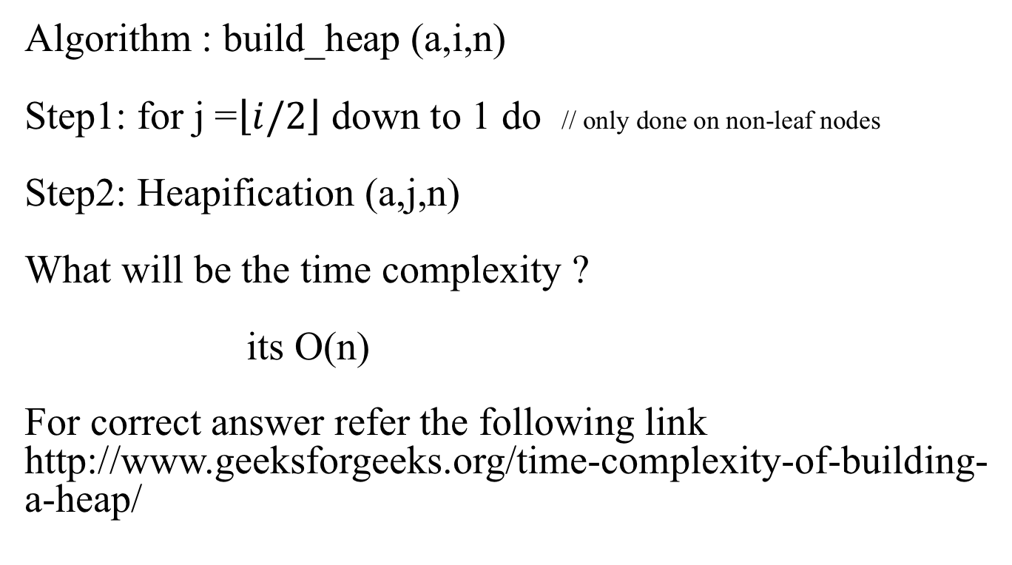
Build-heap Algorithm
Algorithm : build_heap (a,i,n)
Step1: for j =$\left\lfloor i/2\right\rfloor$ down to 1 do // only done on non-leaf nodes
Step2: Heapification (a,j,n)
What will be the time complexity ?
its O(n)
For correct answer refer the following link
http://www.geeksforgeeks.org/time-complexity-of-building-a-heap/

Slide 19
Heap Sort
Given an array of n element, first we build the heap
The largest element is at the root, but its position in sorted array should be at least. So swap the root with the last.
We have placed the highest element in its correct position we left with an array of n-1 elements. Repeat the same of these remaining n-1 element to place the next largest elements in its correct position.
Repeat the above step till an elements are placed in their correct positions.

Slide 20
Heap Sort (Example)
10
2
9
7
9
7
8
5
6
3
8
5
6
3
1
4
2
1
4
10
9
10
9
7
8
5
6
3
1
4
2
8
7
2
9
7
8
5
6
3
1
4
10
4
5
6
3
1
2
10

Slide 21
Pseudocode of the Heap sort
Algorithm heap_sort(a,i)
build_heap(a,i)
for j=1 down to 1 do
swap (a[1], a[j])
heapification (a,1,j-1)
The time complexity of the heap sort algorithm is in
O(nlogn)

Slide 22
Thank You!!

